Slide 1
Topics to be covered
Functionality based IoT Protocol Organization
MQTT
SMQTT
CoAP
REST
XMPP
Asset Management
Telemetry

Slide 2


Slide 3

MQTT:

Slide 4


Slide 5


Slide 6


Slide 7
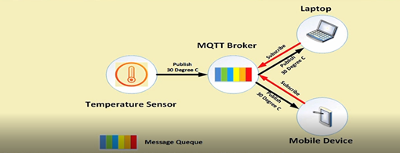

Slide 8
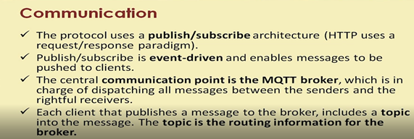

Slide 9
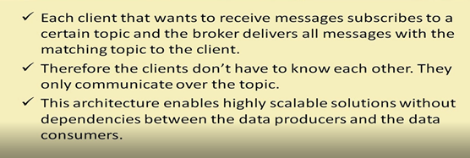

Slide 10


Slide 11
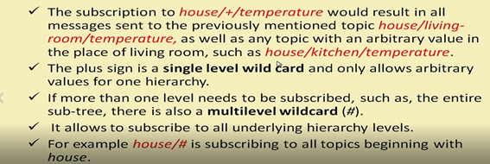

Slide 12
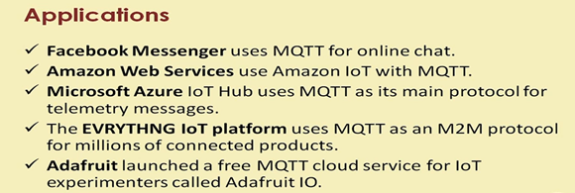

Slide 13


Slide 14


Slide 15

CoAP:

Slide 16


Slide 17


Slide 18


Slide 19
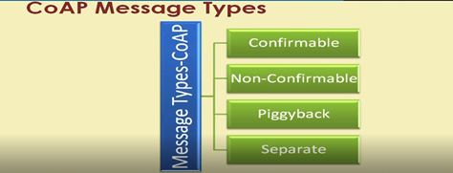

Slide 20


Slide 21


Slide 22
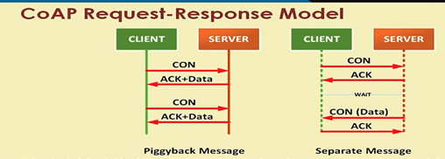

Slide 23


Slide 24


Slide 25


Slide 26


Slide 27
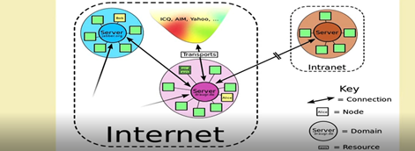

Slide 28


Slide 29


Slide 30
Asset Management
Real Time information
Decrease Human Involvement
Asset Optimization
Asset & Cost Tracking
Enhanced Monitoring Maintenance
Security

Slide 31
IoT Telemetry:
Monitoring data from space crafts
Animal Tracking devices
Heart Monitors
Wearables

